Slide 1

Actor Model
Lapusneanu Gabi
Akka.NET

Slide 2




Silent, a Short Film
Notes:
A look behind "Silent," an animated short created by Academy Award® winning Moonbot Studios.
It celebrates how storytellers, inventors, and technology work together to create cinema magic.

Slide 3


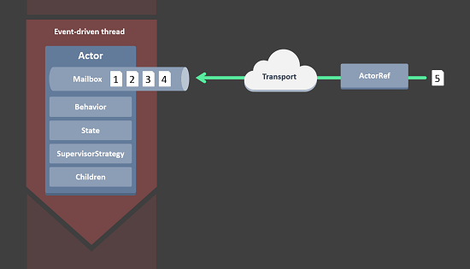

Akka.NET
Introduction
Concepts
Demo

Slide 4
Akka.NET
Introduction
Concepts
Demo

Slide 5

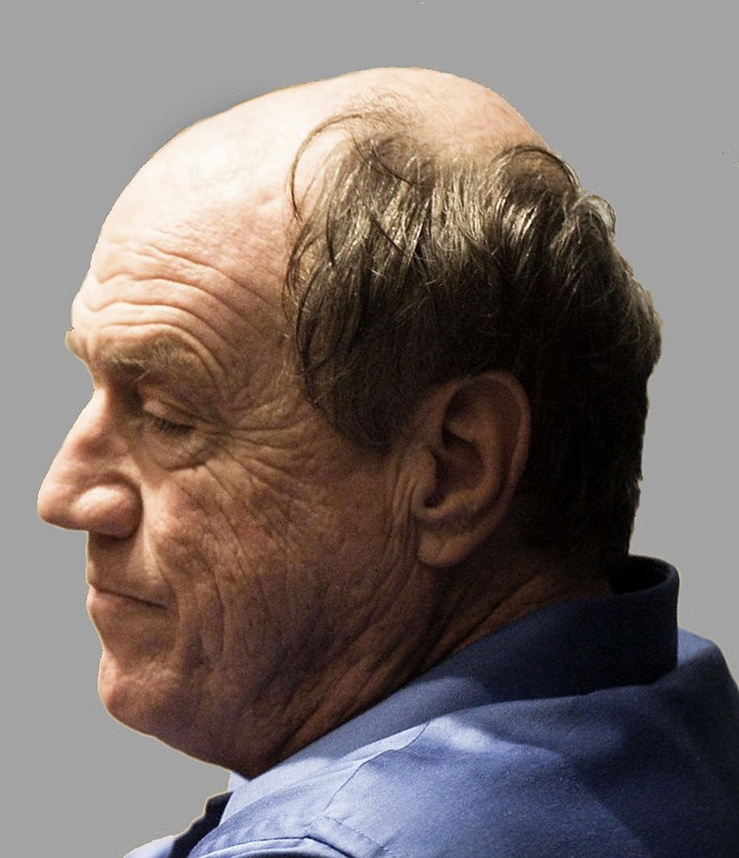
Introduction
Actor Model originated in 1973.
Actor Model is a mathematical model of concurrent computation.
Carl Hewitt
Notes:
The Actor model promotes actors as the first-class unit of computation and emphasizes communication between actors via message sending.

Slide 6


Introduction
Actor Model has mostly been associated with Erlang programming language.

Slide 7










Programming with Actors

Slide 8
Akka.NET
Introduction
Concepts
Demo

Slide 9
Akka.NET
Introduction
Concepts
Demo

Slide 10

The Actor System
The Actor System is our root on actors structure.

Slide 11

The Actor System
The Actor System as a collaborating ensemble of actors is the natural unit for managing shared facilities like scheduling services, configuration, logging, etc.

Slide 12

The Actor
Notes:
Let’s see what is an Actor.
In the Actor model, everything is an actor.
An “actor” is really just an analog for human participants in a system.
Actually it is a simple class which has its own State and Behaviour.

Slide 13

The Actor
Every Actor has a Parent.

Slide 14
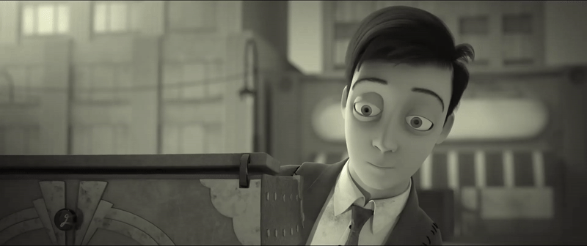
The Actor
Actors communicate with each other through messages.
Notes:
Messages Are Immutable
message passing is asynchronous - the actor who sent the message can continue to do other work while the receiving actor processes the sender’s message.
All Messages Sent Are Placed In A “Mailbox” That Belongs to the Actor.
When the actor is ready to process a message, the mailbox will push the message into the actor’s OnReceive method and run the actor’s message-processing methods.

Slide 15
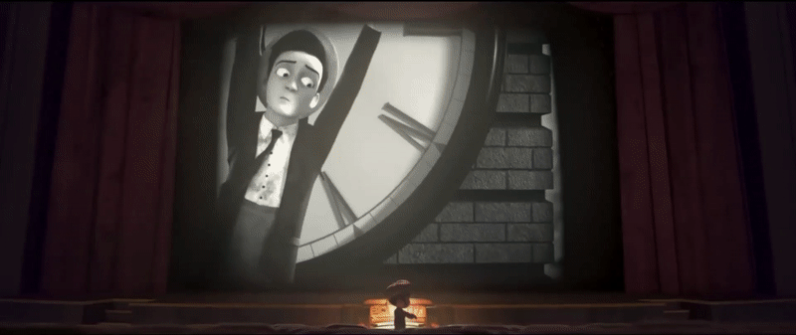
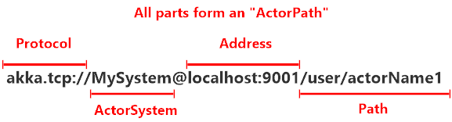
The Actor Path

Slide 16

The Actor
Actors have a well defined Life-Cycle.
Notes:
Actors are created and started, and then they spend most of their lives receiving messages.
In the event that you no longer need an actor, you can terminate or “stop” an actor.
In the event that an actor accidentally crashes (i.e. throws an unhandled Exception,) the actor’s supervisor will automatically restart the actor’s lifecycle from scratch - without losing any of the remaining messages still in the actor’s mailbox.

Slide 17

The Actor
An Actor has its strategy for handling faults of its children.
Notes:
Supervision describes a dependency relationship between actors: the supervisor delegates tasks to subordinates and therefore must respond to their failures. When a subordinate detects a failure (i.e. throws an exception), it suspends itself and all its subordinates and sends a message to its supervisor, signaling failure. Depending on the nature of the work to be supervised and the nature of the failure, the supervisor has a choice of the following four options:
Resume the subordinate, keeping its accumulated internal state
Restart the subordinate, clearing out its accumulated internal state
Stop the subordinate permanently
Escalate the failure, thereby failing itself

Slide 18
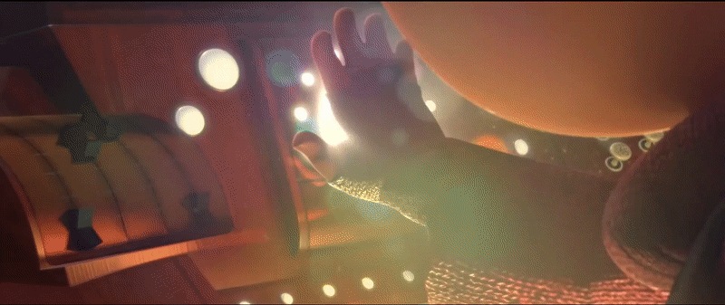
The Actor
An Actor can be remotely deployed.

Slide 19

The Actor
An Actor is reactive.

Slide 21
Akka.NET
Introduction
Concepts
Demo

Slide 22
Akka.NET
Introduction
Concepts
Demo

Slide 23


The End

Slide 24







The Actor System
The Actor System is our root on actors structure.
The Actor System as a collaborating ensemble of actors is the natural unit for managing shared facilities like scheduling services, configuration, logging, etc.
01
Dead Letter
Scheduler
04
02
User Guardian
05
Event System
03
06
System Guardian
Configuration

